Slide 1
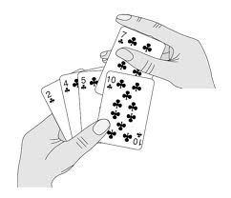

Insertion Sort

Slide 2
Insertion Sort
In insertion sort, each successive element in the array to be sorted is inserted into its proper place with respect to the other, already sorted elements.
We divide our array in a sorted and an unsorted array
Initially the sorted portion contains only one element: the first element in the array.
We take the second element in the array, and put it into its correct place

Slide 3
Insertion Sort
That is, array[0] and array[1] are in order with respect to each other.
Then the value in array[2] is put into its proper place, so array [0]…. array[2] is sorted and so on.
36
36
24
10
6
6
24
24
36
24
10
10
10
10
10
36
24
12
6
6
6
6
36
24
12
12
12
12
12
36

Slide 4
Insertion Sort
Our strategy is to search for insertion point from the beginning of the array and shift the element down to make room for new element
We compare the item at array[current] to one before it, and swap if it is less.
We then compare array[current-1] to one before it and swap if necessary.

Slide 5
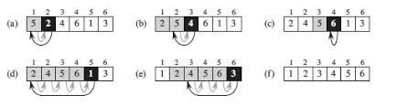
Example: Insertion Sort

Slide 6
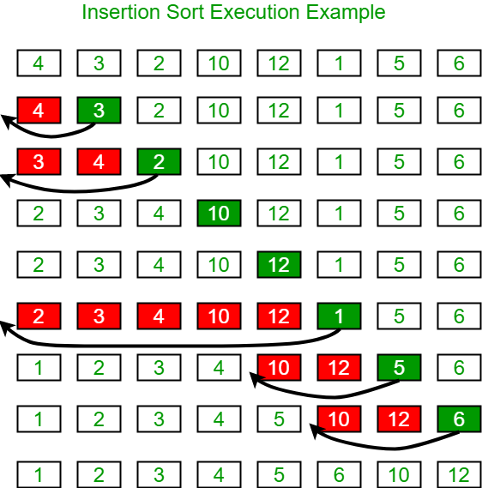
Example: Insertion Sort

Slide 7
Insertion Sort Algorithm
Algorithm 2.1: INSERTION-SORT(A)
1 for j 2 to A.size do
2 key= A[ j]
// Insert A[ j] into the sorted sequence A[1 . . j -1]
3 i = j -1
4 while i > 0 and A[i] > key do
5 A[i +1]= A[i]
6 i--;
7 endwhile
8 A[i +1] key
9 endfor

Slide 8
Insertion Sort Algorithm
void insertionSort(int array[], int length)
{
int i, j, key;
for(j = 1; i < length; j++)
{
key = a[j];
i=j-1
while( i>=0 && a[i] > key)
{
a[i + 1] = a[ i ];
i--;
}
a[i + 1] = key;
}
}

Slide 9
Thanks

